Slide 1
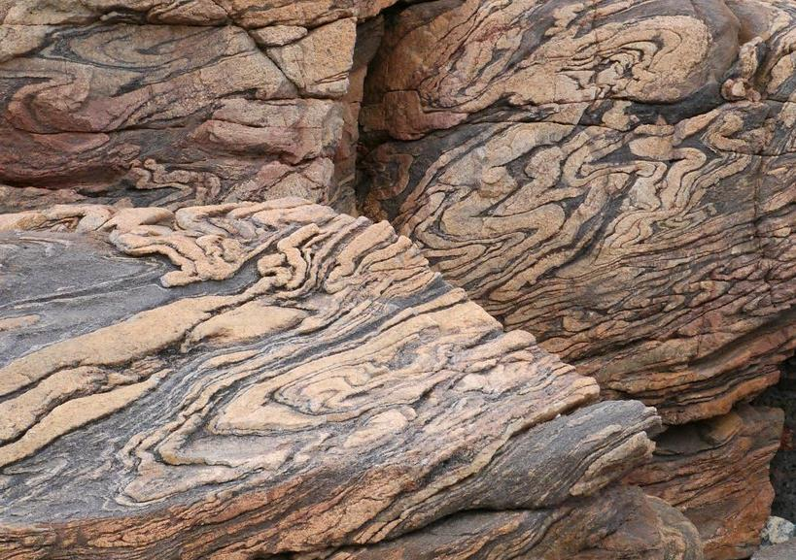
EART11100: Understanding the Earth
A dynamic Planet
Introduction to Metamorphism

Slide 2
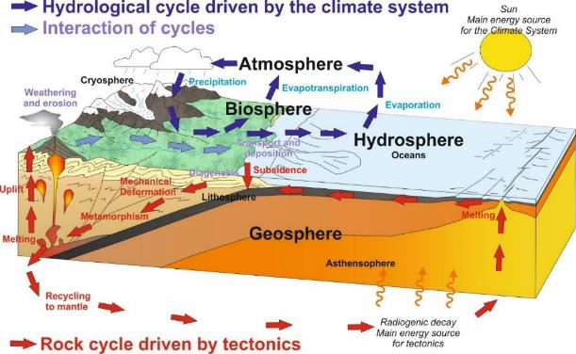
Intended learning outcomes
… you should be able to…
define metamorphism, and describe the principal changes that occur.
describe the main causes of metamorphism, and describe how tectonic setting controls temperature, but not pressure.
describe the relationship between deviatoric stress and metamorphic texture.
explain why different kinds of metamorphic rock form, and
how recognising different kinds of metamorphic minerals and fabrics can tell us where they formed.

Slide 3
What is metamorphism?
From “meta” (change) and “morph” (shape)
Changes in the mineralogy and texture (shape and size of minerals) that occur in the solid state (strictly no melting).
Response to the addition of thermal energy (heat) and mechanical energy (work)… change to an equilibrium state.
It doesn’t change the bulk chemical composition of the rock
→ it is a closed system process.
→ i.e. one that involves transfer of energy but not material.
The exceptions are…
  → Volatiles (H₂O & CO₂) are lost (H₂O abundant in crystal structure of clays, CO₂). They can also sometime be added.
  → Metasomatism – metamorphism caused by the addition or removal of elements by the pumping of hot, saturated pore waters.
Not concern ourselves too much with these for now.

Slide 4
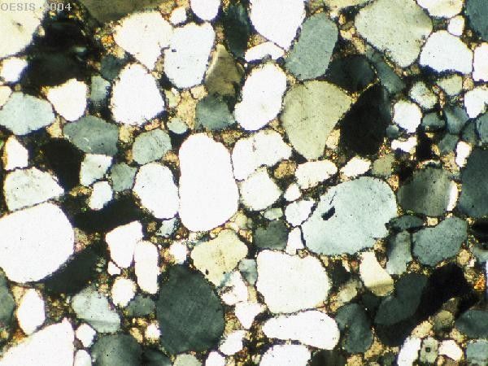
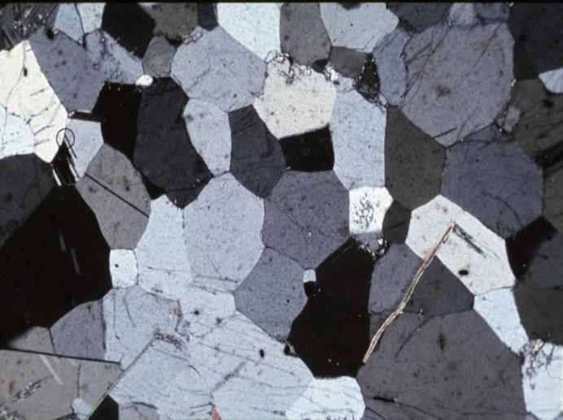
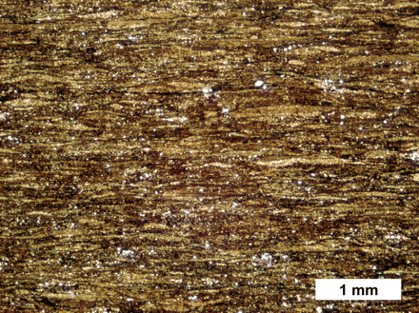
What happens during metamorphism?
1. Recrystallisation – existing minerals adopt new textures (shapes and sizes). Some minerals adopt a preferred orientation (as we will see).
Sandstone → Quartzite
Quartz has recrystalised in the solid state from a rounded, abraded sedimentary texture to an interlocking “granoblastic” texture. No new minerals.

Slide 5
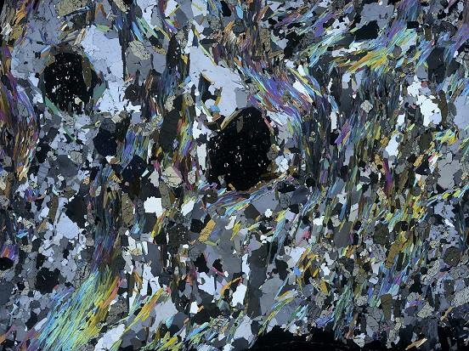
What happens during metamorphism?
2. Neomineralisation – the formation of new minerals at the expense of existing ones (new formulae and polymorphs).
  Involves chemical reactions between minerals (± fluid)
Shale → Schist
A variety of elements in the clay minerals in the shale have recombined to form micas (colourful), garnets (black blobs) and stauralite (whites and greys). Note that the new minerals also don’t have the same size as before.

Slide 6
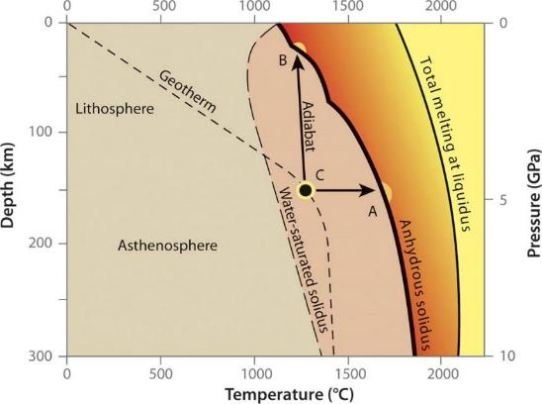
Melting temperatures of mantle peridotite as a function of pressure (depth)
What is metamorphism?
Metamorphic rocks are volumetrically more abundant in the Earth’s crust (and upper mantle) than igneous and sedimentary rocks put together…
…and host economically important mineral deposits.
They tend not to undergo retrograde metamorphism (revert back to the original rock type when they are exhumed and cooled)…
… so they can be studied to understand what processes operate deep inside the Earth.

Slide 7
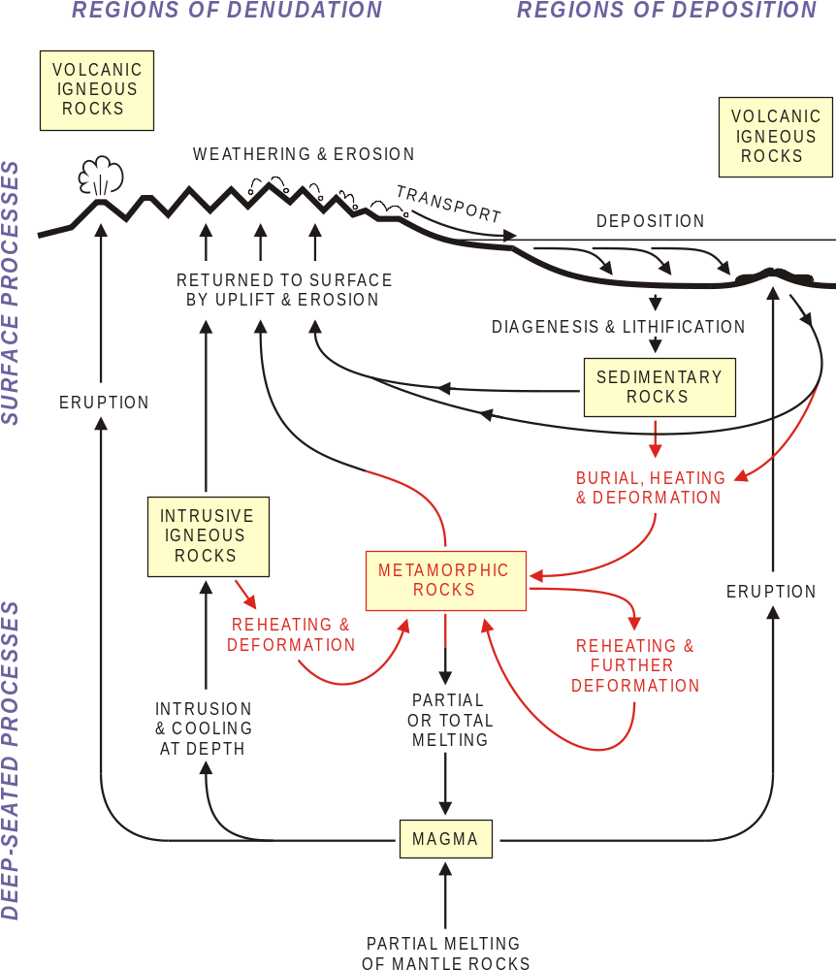
What is metamorphism?
All types of igneous and sedimentary rocks can (potentially) be subjected to metamorphism.
Metamorphic rocks can be derived from any kind of precursor rock (protolith) and therefore collectively show a very large range in bulk compositions.
A rule of thumb is that increasing metamorphic grade = increases size of crystals (but depends on grain size of protolith, obviously!).

Slide 8
Causes of metamorphism
Two main agents:
1. Temperature → “Original heat” (the Geothermal Gradient)
→ “Local heat” (igneous intrusions)
2. Stress → Load Pressure
→ Deviatoric Stress
Notes:
n

Slide 9
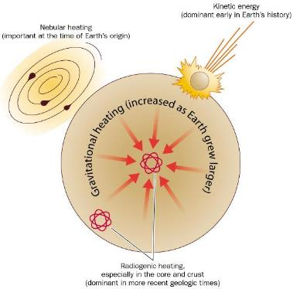
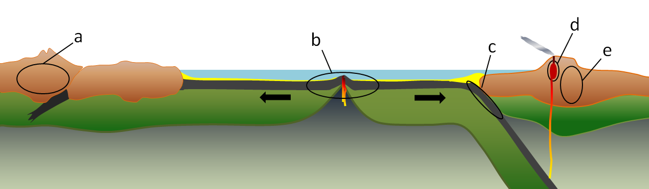
Causes of metamorphism: heat
Original heat
The geothermal gradient (accretionary and differentiation kinetic energy, radioactive decay) is on average 25-30ºC/km.
But it is variable depending on tectonic setting….

Slide 10
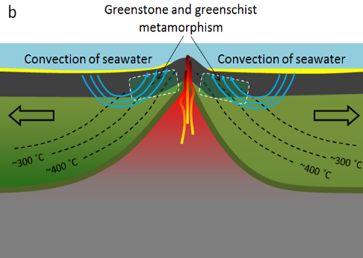
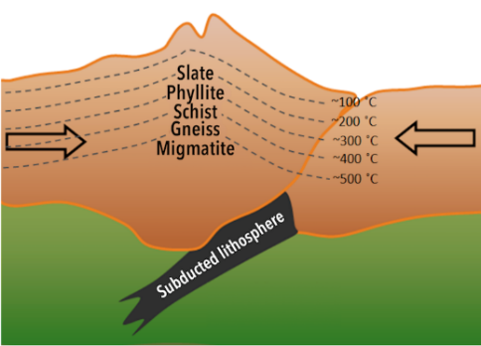
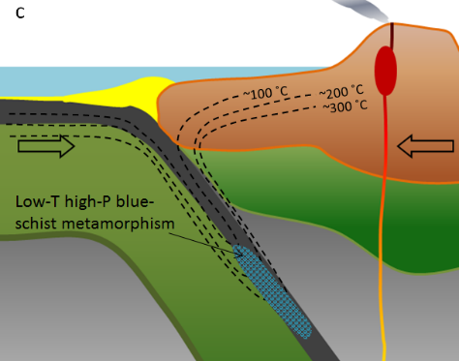
Causes of metamorphism: heat
B
A
C
Cold subduction zone
3-5ºC/km
Average continental geotherm
But burial results in increasing T
P
(Depth)
25-30ºC/km
Mid ocean ridges
50ºC/km
Volcanic areas/(contact metam)
>100ºC/km

Slide 11
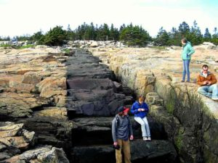
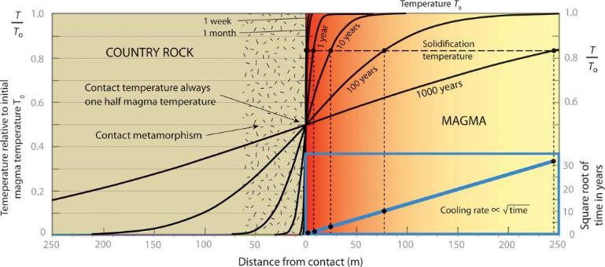
Causes of metamorphism: heat
2. “Local” heat – igneous intrusions
Common in the settings discussed in Week 3.
Intense local heat source
Disturbs the “normal” geothermal gradient.
Strong, but localised metamorphic effects.

Slide 12
Causes of metamorphism: stress
Stress (S) is defined as the average force per unit area that some particle of a body exerts on an adjacent particle, across an imaginary surface that separates them
  →i.e. Stress (S) = Force (F) / Area (A).
  →It is intuitive that a cube of sandstone with sides of 25 cm submitted to a compressive force of 10 tonnes (10,000 kg) may deform insignificantly, compared to the same force being applied to a cube of the same material but with sides 1cm (which likely would be pulverised).
Therefore the behaviour of material is measured against units of stress (Pascals=Newtons/m²) rather than force.

Slide 13

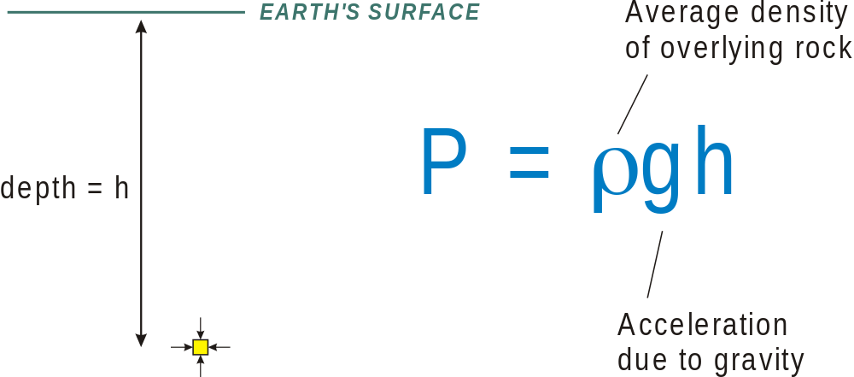
Causes of metamorphism: stress
In the Earth’s crust, stress can be resolved into two parts:
1. Load pressure: (= ‘lithostatic stress or confining stress):
Results from the weight of overlying rock.
Stress acts uniformly in every direction
(Analogous to the hydrostatic pressure beneath a head of water)
Depth

Slide 14
Causes of metamorphism: stress
Does load pressure vary with tectonic setting?
Yes, but negligibly compared to temperature.
By approx. 3.5x10⁸ Pa
(3.5 Kbar)/km
2.8-3.1
Depth

Slide 15
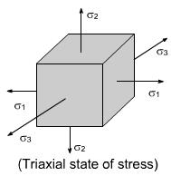
Causes of metamorphism: stress
2. Deviatoric (differential, or triaxial) stress
In some settings, stresses do not act uniformly on the rock (not simple lithostatic stress).
What could be the cause of non lithostatic stress?
Caused by lateral transmission of horizontal tectonic forces through the solid Earth’s crust (contraction or extension).
In the real 3D world (which always includes gravity), there will always be three principal, perpendicular stresses acting on an object
  →б₁ the maximum principal stress
  б₂ the intermediate principal stress
  б₃ the minimum principal stress

Slide 16

Causes of metamorphism: stress
Compressive force at convergent plate margins → deviatoric stress.
Extensional force at divergent plate margins → deviatoric stress.
Results in fracturing (faulting) in cold, brittle upper crust.
Results in plastic deformation (folding) in warm ductile middle & lower crust. (Heat reduces the strength of rock.)
We looked at this in Week 5
Hot rocks are weak, so they resolve (and dissipate) deviatoric stresses by deforming plastically.
So deviatoric stresses have minimal effect on mineral stabilities…

Slide 17
Causes of metamorphism: stress
... but can have a major effect on texture.
Existing minerals may be compressed, elongated or rotated.
New minerals’ shape and orientation also guided by deviatoric stress.
1. Rotation and regrowth of flaky minerals into parallelism, resulting in the development of cleavage perpendicular to б₁:
Rotated
flakes
New
flakes
In medium/coarse-grained
rocks, cleavage is usually
termed ‘schistosity’.
Cleavage
direction

Slide 18
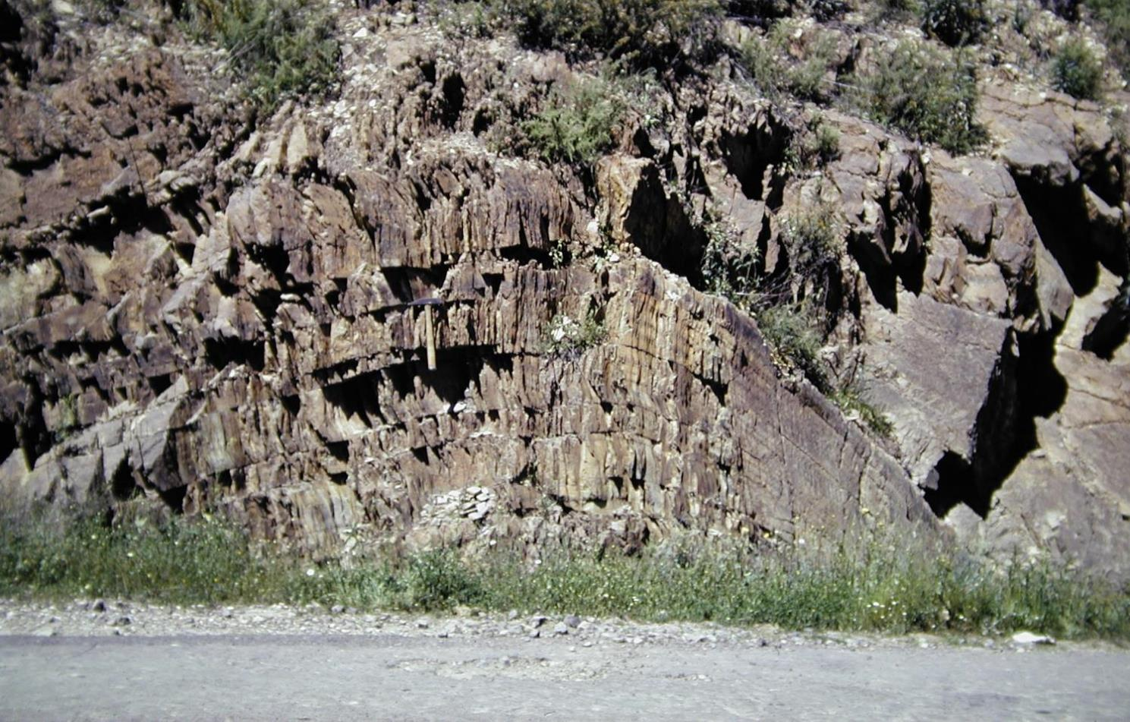
Causes of metamorphism: stress
Folded metamorphosed mudstone (slate), with axial-planar cleavage

Slide 19
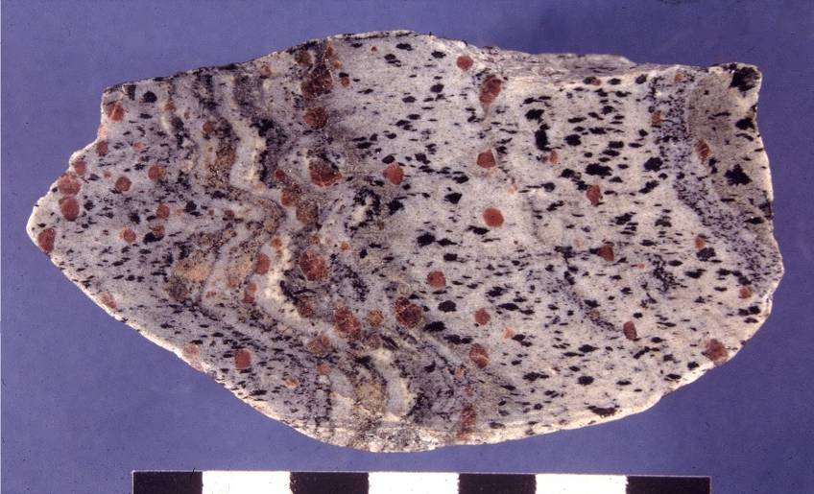
Metamorphosed mudstone (garnet mica schist), with folded bedding and axial-planar schistosity
Causes of metamorphism: stress

Slide 20
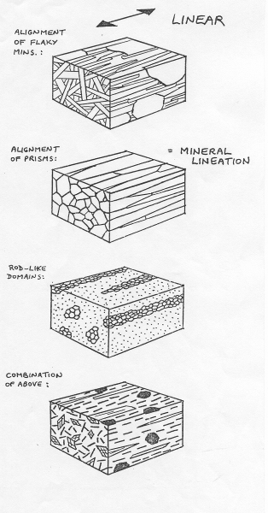
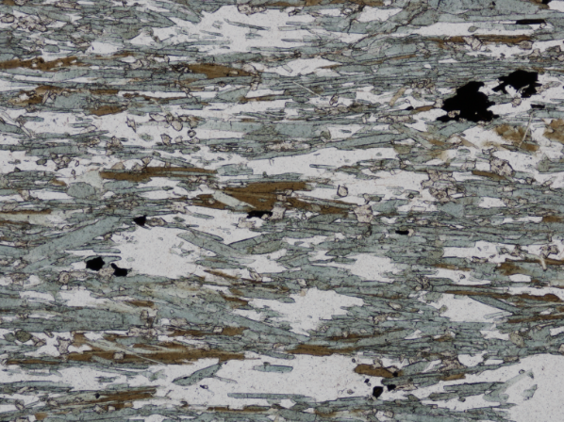
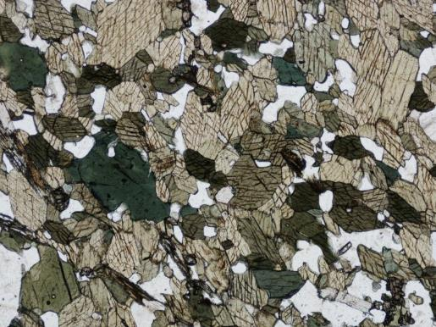
Causes of metamorphism: stress
Another type of tectonic fabric is a lineation (linear fabric of metamorphic origin).
Lineations often record stretching strains
(where σ1 ~ σ2 >> σ3).

Slide 21
Summary
Two main agents:
1. Temperature → “Original heat” (the Geothermal Gradient)
Varies strongly according to tectonic setting
→ “Local heat” (igneous intrusions)
Can locally cause metamorphism
2. Stress → Load Pressure
Increases with depth, but doesn’t really vary with tectonic setting
→ Deviatoric Stress
Doesn’t cause metamorphism, but can influence the texture of the metamorphic rock.
Notes:
n

Slide 22
Metamorphic facies
We have seen that metamorphism is caused by
→increased T
→Increased P
That results in
→formation of new minerals
→increase in crystal size
→reorientation and segregation of crystals if there are significant deviatoric stresses.
We have also seen that
→ T increases with depth (geothermal gradient) differently in different places
→ but P increases more-or-less linearly with depth.
Therefore we have a single variable (T).
→ We can work out where a metamorphic rock formed based on its composition and texture.

Slide 23
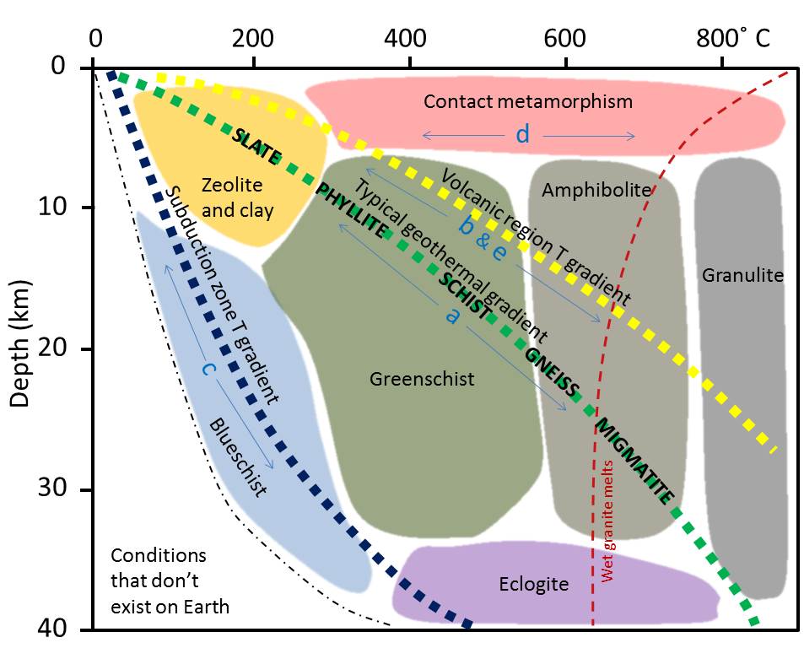
Metamorphic facies
Metamorphic facies are sets of mineral assemblages that form under distinct pressure and temperature fields.
Broadly, we can divide metamorphism into three categories
→Regional metamorphism, where T and P increase.
→Contact metamorphism where T increases and P does not.
→Dynamic metamorphism where P increases but T does not.

Slide 24
Regional metamorphism
Most common way of metamorphosing rock is to thicken the crust
→Usually via subduction of one crustal slab beneath another
Ocean-continent or continent-continent collision.
Termed “Regional metamorphism”
→Increase in T and P (see a, b, c, d, e)

Slide 25
Regional metamorphism
→Distinct mineral assemblages with increasing T and P
→Grainsize increases with increasing T and P.
Regional metamorphism is almost always associated with contraction (deviatoric stresses), so…
→Development of cleavage to schistosity with increasing T and P.

Slide 26
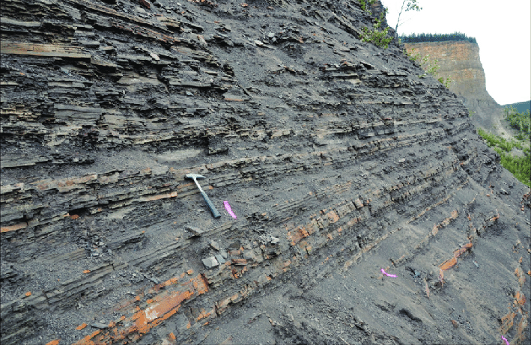
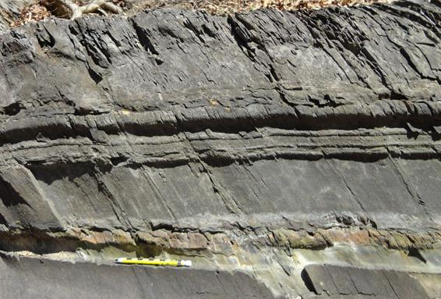
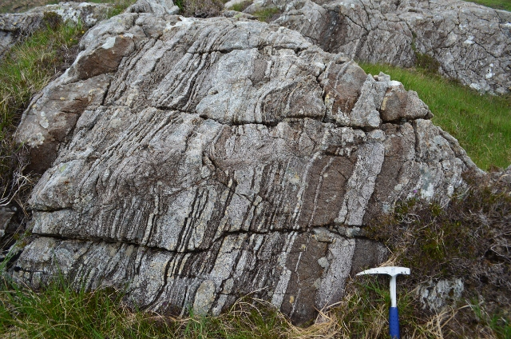
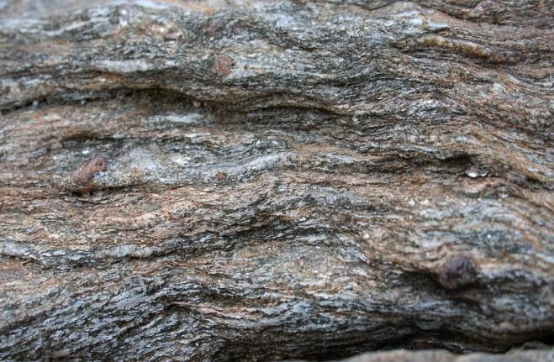
Regional metamorphism
Slate
→
Protolith (e.g. mudstone)
→
(Green)schist
→
Gneiss

Slide 27
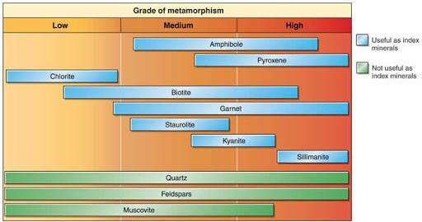
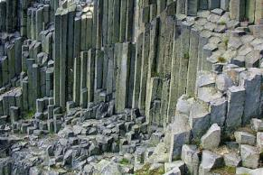
Regional metamorphism
Let’s look at the concept of metamorphic grade…
As the protolith (parent rock) is buried, minerals transform from one into the other with increasing rank.
Form three assemblages (for convenience)
Learn the concept, not the minerals (for now)
Mudstone
Basalt

Slide 28
Regional metamorphism
10
S
G
t
t
+
S
K
F
G
+
B
t
y
e
t
t
+
+
-
+
C
+
B
y
C
B
h
t
B
h
t
l
Q
t
K
l
l
+
+
l
)
8
+
+
z
i
r
M
H
+
M
H
S
s
2
H
s
2
a
O
2
+
O
b
Standard “Barrovian” geothermal gradient
O
Q
O
k
z
z
2
(
Q
H
6
+
+
s
e
s
f
M
K
r
M
+
l
l
u
e
i
l
S
s
t
s
S
4
S
i
e
i
l
A
l
A
l
n
l
r
n
d
P
y
d
K
d
n
A
2
z
O
Q
2
+
H
s
+
s
M
f
K
d
+
n
0
A
0
200
400
600
800
1000
Temperature (°C)
Rock is a poor conductor of heat.
So P increases at a faster rate than T.

Slide 29
Regional metamorphism
10
S
G
t
t
+
S
K
F
G
+
B
t
y
e
t
t
+
+
-
+
C
+
B
y
C
B
h
t
B
h
t
l
Q
t
K
l
l
+
+
l
)
8
+
+
z
i
r
M
H
+
M
H
S
s
2
H
s
2
a
O
2
+
O
b
O
Q
O
k
z
z
2
(
Q
H
6
+
+
s
Individual
P-T paths
e
s
f
M
K
r
M
+
l
l
u
e
i
l
S
s
t
s
S
4
S
i
e
i
l
A
l
A
l
n
l
r
n
d
P
y
d
K
d
n
A
2
z
O
Q
2
+
H
s
+
s
M
f
K
d
+
n
0
A
0
200
400
600
800
1000
Temperature (°C)
As burial ceases, the relatively cold rock can continue to warm.
Resulting in an arcing P-T profile.

Slide 30
Regional metamorphism
10
S
G
t
t
+
S
K
F
G
+
B
t
y
e
t
t
+
+
-
+
C
+
B
y
C
B
h
t
B
h
t
l
Q
t
K
l
l
+
+
l
)
8
+
+
z
i
r
M
H
+
M
H
S
s
2
H
s
2
a
O
2
+
O
b
O
Q
O
k
z
z
2
(
Q
H
6
+
+
s
Individual
P-T paths
e
s
f
M
K
r
M
+
l
l
u
e
i
l
S
s
t
s
S
4
S
i
e
i
l
A
l
A
l
n
l
r
n
d
P
y
d
K
d
n
A
2
z
O
Q
2
+
H
s
+
s
M
f
K
d
+
n
0
A
0
200
400
600
800
1000
Temperature (°C)
The mineral assemblage reflects the highest T attained, not P.

Slide 31
Regional metamorphism
Why use mudstone and basalt as protolith case studies?
Thought experiment… what are the main possible rock types that can be metamorphosed?
Other rock types dominated by textural change.
Mudstone
Basalt

Slide 32
Contact metamorphism
Rocks in contact with an intrusion often encounter high T, without high P (see d).
These often happen in the same places as where igneous rocks are produced (Week 3).
→Continental and ocean crust extensional settings, above mantle hotspots, hydrated subducting slabs.

Slide 33
Contact metamorphism
→Distinct mineral assemblages with increasing T
→Grainsize increases with increasing T.
Not associated with increased stress, so…
→No foliation developed.

Slide 34
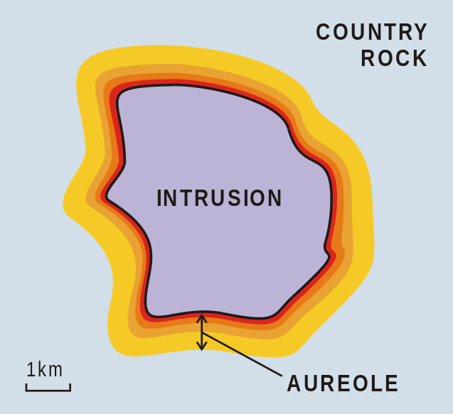
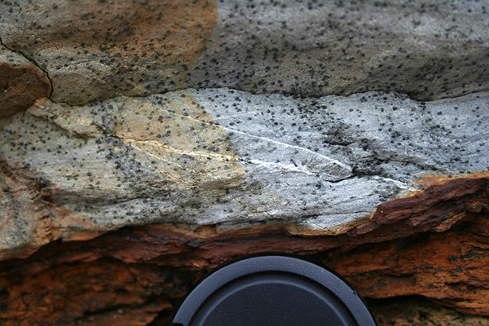
Contact metamorphism
Products of contact metamorphism are called “Hornfels”
→ Non-foliated (“granoblastic”) rock, with distinct increase in crystal growth size
Often with formation of recrystalised aggregate “spots” (“porphyroblasts”).
A clue is that the intruded igneous rock should be nearby ;-)
Hornfels (spotted rock)
→
Protolith (e.g. mudstone)

Slide 35
Dynamic metamorphism
Dynamic metamorphism happens when stress pressure is applied, but little temperature.
This stress is usually deviatoric (not burial – so we don’t plot on a Temp./Depth profile), and is common…
Along faults, in the immediate zone where stress is focussed.
Usually results in grain size reduction:
  Brittle grain size reduction (cracking, no recrystallisation)
→ cataclastic rocks (breccia, etc.)
  Ductile grain size reduction (dynamic recrystallisation)
→ mylonites
Not really a metamorphic rock

Slide 36
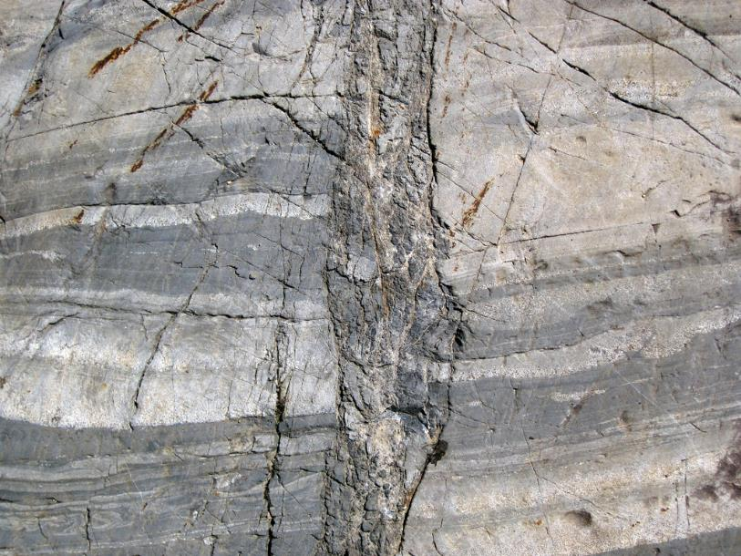
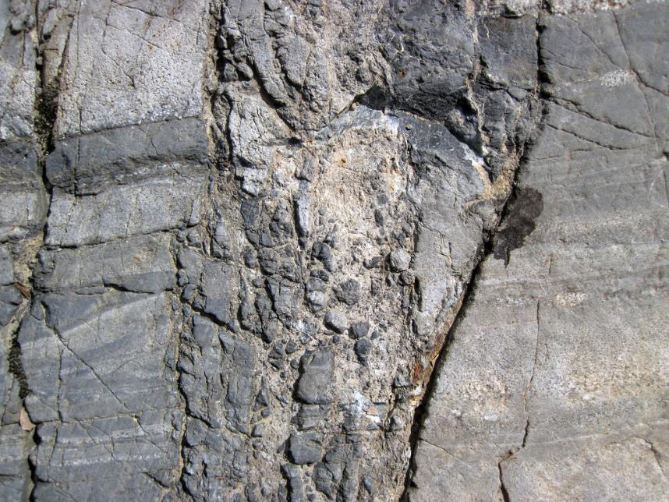
Dynamic metamorphism
Cataclastic fault breccia

Slide 37
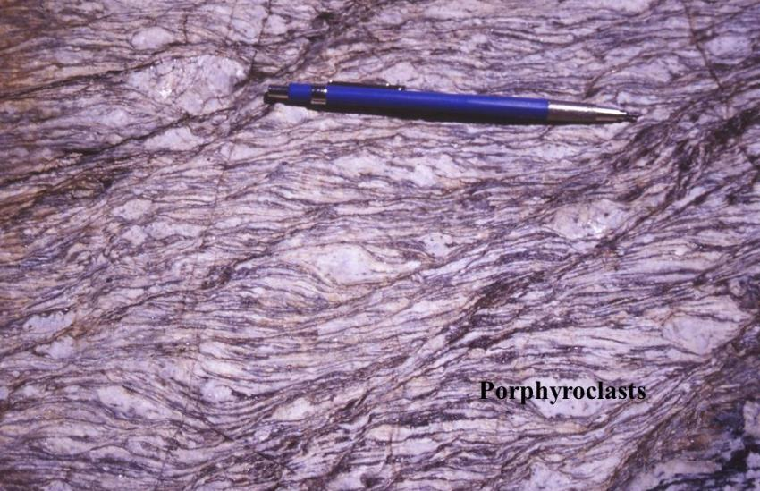
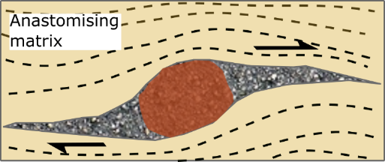
Dynamic metamorphism
Mylonites typically develop a distinct foliation
Oriented parallel to orientation of shear
And also contain outsized crystal masses (“porphyroclasts”) that haven’t broken down, which give a sense of the shear
A clue is that the rock is usually obviously in a fault or fault zone ;-)
What is the sense of shear in this photo? Top to the left or top to the right?

Slide 38
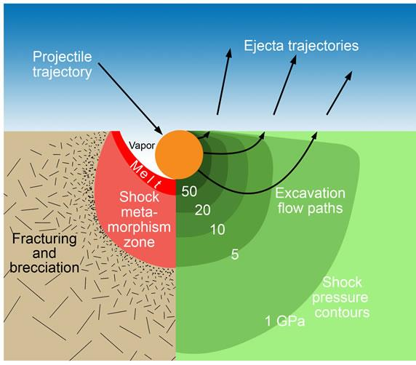
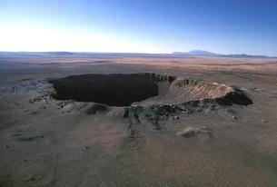
Dynamic metamorphism
During meteor impacts (these are fun but rare).
Very high pressures (10s GPa!) but modest temperatures lead to the formation of minerals that don’t normally naturally occur.
→ Normal load pressure gradient is 3.5 Gpa/Km

Slide 39
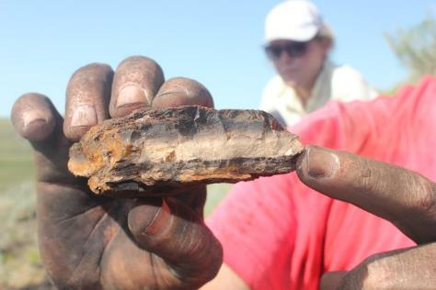
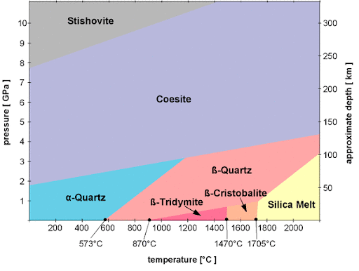
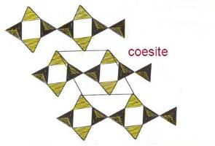
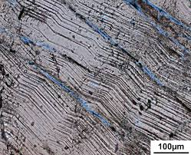
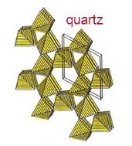
Dynamic metamorphism
Key evidence for impact at the Cretaceous-Tertiary boundary 65 Ma is the widespread formation of coesite (high T polymorph of quartz) at the impact site…
…and the distribution of shocked quarts – where the normal crystal lattice has been disturbed – at sites 1000s km from the impact.

Slide 40
Why don’t the minerals retrograde?
Retrograde reactions generally fail to happen because ...
1. rocks lose energy as they cool, so do not receive the necessary activation energy for the reaction to happen.
many prograde reactions involve release of volatiles
(devolatilisation reactions):
dehydration reactions: involve release of H₂O
decarbonation reactions: involve release of CO₂
(e.g. calcite + quartz → wollastonite + CO₂)
But once lost from the rock, the volatiles are not available for the retrograde reaction:
wollastonite + CO₂ → calcite + quartz
This is useful, because it allows us to look at the metamorphic rocks and reconstruct the processes happening deep in the Earth’s crust.

Slide 41
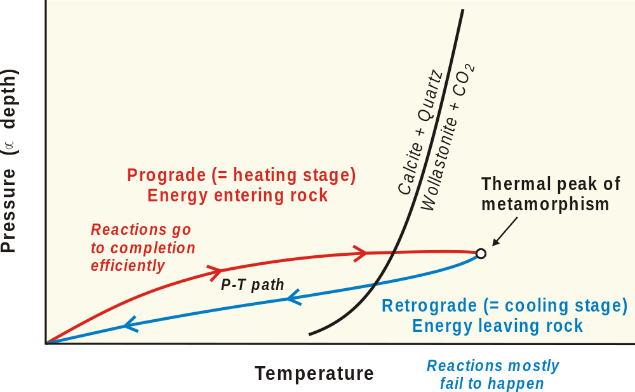
Why don’t the minerals retrograde?

Slide 42


Further reading
Marshak, Earth: Portrait of a Planet, Ch. 7.
Grotzinger and Jordan, Understanding Earth, Ch. 6 and 7.

